Slide 1
The Symbolic Inheritance Stream
Is RFT Plausible and Usef

Slide 2
Liam joined the Symbolic Stream, Darin Started to see it…
Notes:
Noticing how I say things – marriage
Just be happy…
Has to make sense to you….No it has to be experientially useful to him. The DRR may be nonsense!

Slide 3
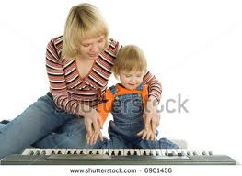
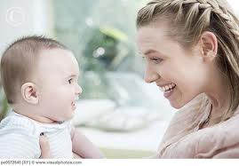
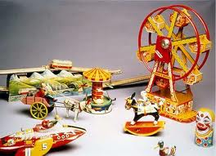
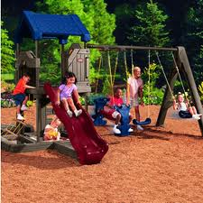
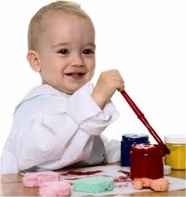
Information Source: First Member of Verbal Community
PARENT
GAZE
GESTURE
EXPRESSIONS
INSTRUCTIONS
NOVEL EVENT
CHILD
CHALLENGING EVENT
UNCERTAINTY
(ANXIETY)
UNCERTAIN EVENT
MEANINGFUL OUTCOME
Notes:
Child needs to learn about the world.
When unsure or new she will seek out mum (info source) via attending, gesture, word
Mum will check with world and direct child with gaze, gesture, expression or language
The child can then learn how to respond to themselves themselves MUCH MUCH FASTER than experiential learning.
RULES are fastest… Yes you can hit the ball when it rolls onto the grass…

Slide 4
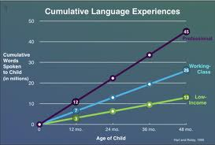
Hart & Riseley
Notes:
2.5 years looking at 42 families.
Welfare heard 616 words per hour, while children from professional families (essentially children with college educated parents) heard 2153 words per hour.

Slide 5
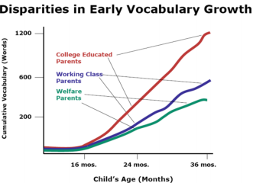

Slide 6
Non-Business Talk: Not Just Size
Because it's about the esoteric, the topics are different. That was the second discovery.
When talkative parents talk more they are not talking more business. They are talking about "what ifs," and "remembers", and the past, and all the elaborations. My guess is that the more esoteric things you look at, that you want to count in children's experience, mathematics, quantities, and so on, social relationships, the more complex and sophisticated, the more likely they are to show up in more talkative families.
Dr Todd Risley

Slide 7
Cognitive Development
O’Hara, Pelaez, Barnes-Holmes (2005)
Looked at same/diff, before/after
Vocabulary, Arithmetic and digit symbol coding.
Passing relational test strongly predicted Vocabulary scores and Arithmetic on WAIS III.

Slide 8
OK so it Predicts? But is useful?
Because RFT tells analyses contextual influence to show how a history of exposure creates networks in the brain in a predictable fashion.
It tells us how to arrange contexts to create those conditions.
At a micro and macro level
With freedom to be as creative as can be.

Slide 9
IQ and Relational Operants
Cassidy, Roche and Hayes 2011
Study 1
8 kids. 4 experimental & 4 control
8-12 years of age
Method
Trained and tested for standard equivalence
Trained on nonsense cues for SAME & OPPOSITE using MEI
Trained on MORE/LESS using MEI

Slide 10
Performance jump = av 100 – 132 (sig)
Verbal jump = av 109 – 127 (sig)

Slide 11
Cassidy, Roche & Hayes, 2011

Slide 12
Special Needs?
Study 2.
8 Kids (ages 11-12)
Identified by schools as educationally at risk/ delayed
Slightly different training than study 1 as more efficient sequences for establishing relational responding had been published/ identified.
Remedial protocols from Beren’s were used to speed up learning of pre-requisite abilities
6-14 weeks of training across 9 months

Slide 13
Results
Mean improvement = 13.1 pts (sig)
Verbal Comprehension: 10.1 pts (sig)
Perceptual reasoning: 12.38 pts (sig)
Processing speed: 16.17 pts (sig)

Slide 14
Useful?
Gallagher (ECU – private practice)
3 kids 4:6-6:11 diagnosed with AD
Pre and post measures on
1st order (sally anne – mum leaves the room)
2nd order (person left in the room)
McHugh protocol administered
60-90 minutes per week for 12 weeks
56 steps in the sequence

Slide 15
DV’s
First order and second order Theory of Mind
Memory questions (eg ‘what was hidden?’)
Control questions (eg ‘where is the hat really?’)
Scores:
0/8 at pre-test
8/8 at post-test
Maintained at 1 and 3 months

Slide 16
Example Protocol for Teaching Comparative
PHASES | STIMULI | Cfunc
Relational Responding | Salient MEI highlight Rel Cue | Receptive, Tact
Arbitrary Applicable Relational Responding Neutral Stimuli present | Highlight Crel “bigger”/”smaller? | Receptive, Tact
Arbitrary Applicable Relational Responding Stimuli no present | Meaningful stimuli already known to crazy stuff | Intraverbal

Slide 17
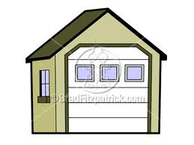
Frame of Forks in the Road
Bigger
Smaller
Smaller
Bigger

Slide 18
Frame of Forks in the Road
Bigger
Smaller

Slide 19
Forks in the Road

Slide 20
Combinatorial Frame
Bigger
Is
Smaller
Is
Not
Not

Slide 21
Bigger
Smaller

Slide 22
Relating Relations
Mrs Cook
Likes Bigger more
Bigger
Smaller
More
Less

Slide 23
Relating Relations
Bigger things are heavier
Bigger
Smaller
Heavier
Lighter

Slide 24
Frame of Forks in the Road
Bigger
Smaller

Slide 25
Is It Useful?
Ok so you can teach kids better…
But it changes the way we pass on information to the information sources.
The transmitters of symbolic processes
Parents
Teachers
Authorities
Narratives
Institutions
As a symbolic species we add to the symbolic stream so that we can make it work better for its adaptive purpose…

Slide 26
The Symbolic World
No one should make you feel bad
caused
Bad Feeling
Bad Feeling
Past
Present
Future
Cause - Effect
Cause - Effect
Mum you scared me! You are bad!

Slide 27
PREDICTIVE INFORMATION SOURCE
NON-DESIRED RESPONSE
NATURAL
P+
ARTIF.
P+
CUE
TARGET
NATURAL R+
ARTIF.
R+
INFORMATION SOURCE

Slide 28
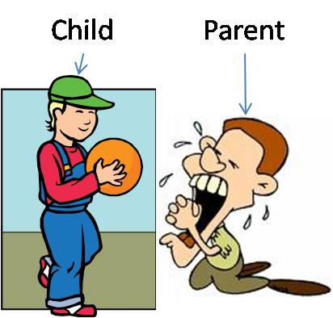
The Three Types of Parents
Artificial Punishment
Natural Punishment
Guiding Parent
Natural Reinforcement
Artificial Reinforcement
Notes:
Art Punishment = Things we do to decrease behaviour that are all about Pliance (but needed cause the tracking to a car hitting you as a lesson ain’t ok)
Nat Punishment = If you do not bring in the wood then there is no fire. If we have no fire then we have to go get it. If we have to go get it then no one makes dinner… and you go hungry
Nat Reinforcement = the developmental reinforcers for growing and developing within a family and moving in the direction meaningful development in a contextually sensitive way
Art Reinforcement = rewards we use that can be tracked but they have limited context to them
Guiding parent. When the child leaves the green zone. The healthy developmental space. We have to guide them by explaining where the tracks lead. If there is no track in the green zone that is maturally meaningful for the child - then we need to make the green zone bigger. If there is no natural punishment in the red zone - then WHY are we asking them not to do it????
Over time the Green zone gets bigger and the guides become many. The natural punishers also expand. The artificial ones should be minimal as our society has a limited place for Pliance.

Slide 29
Tracking Transforms Stimulus Functions
Jeff (9) (aka ‘chicken boy’)
Referred for non-compliance, social delay, unusual motivation.
Dad motivated using punitive
Mum reasoning and appealing main form of motivation
Some Academic Delays
Both were consistent and wanted to help.
Taught Tracking
Nothing really different in the context.
Punishment was educational and naturally occurring.
Perspective was highlighted.
Approach options were created.
Delivery was calm and meaningful.
Prediction was the purpose not control.
Mum – two bounce rule to stop the ‘why’ traps
Dad – taught mapping to see empowerment that punishment of to allow the teacher to work not to do the teaching.

Slide 30
Results…
6 sessions. 12 weeks.
Behavioural Issues almost all gone.
Developmental behaviours increasing (in unexpected ways)
School problems largely gone.
24 weeks maintained
School gets 2.5k grant for staff training for all kids (5 primary focus)
Principal and deputy stunned by results – numerous psychologists tried before with no results. Including a national expert funded by Education Department and Federal Government..

Slide 31
Changing the Location of the Info Source
SYMBOLIC – mum is always in the way!

Slide 32
Using the Symbolic Stream to Promote a better Symbolic Stream?
Star Shapes won’t roll…
Won’t roll
Not star - Will Roll
Notes:
Noticing how I say things – marriage
Just be happy…
Has to make sense to you….No it has to be experientially useful to him. The DRR may be nonsense!

